Slide 1

NORTHWOODS LEAGUE PITCH CLOCK UPDATE
JIM MISUDEK
FOND DU LAC DOCK SPIDERS

Slide 2
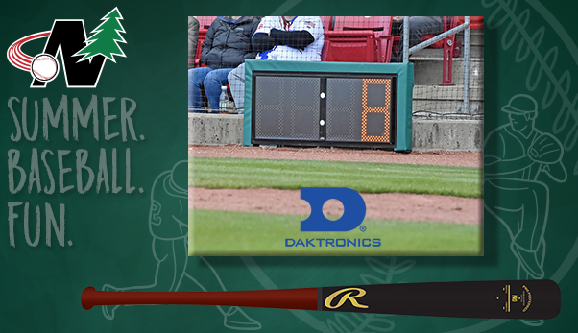
HOW IT STARTED
Pitch clocks installed prior to the 2023 season
Purchase costs shared between the clubs and NWL
$10,200 per unit, plus installation
Had been used in professional baseball with great success – roughly 30 minutes per game improvement
MiLB/MLB Background

Slide 3
FIRST YEAR RESULTS
2022 (Final year without field timing): 3:05 NWL average
2023 (First year with field timing): 2:50 NWL average
Closer to 2:30 optimal time

Slide 4
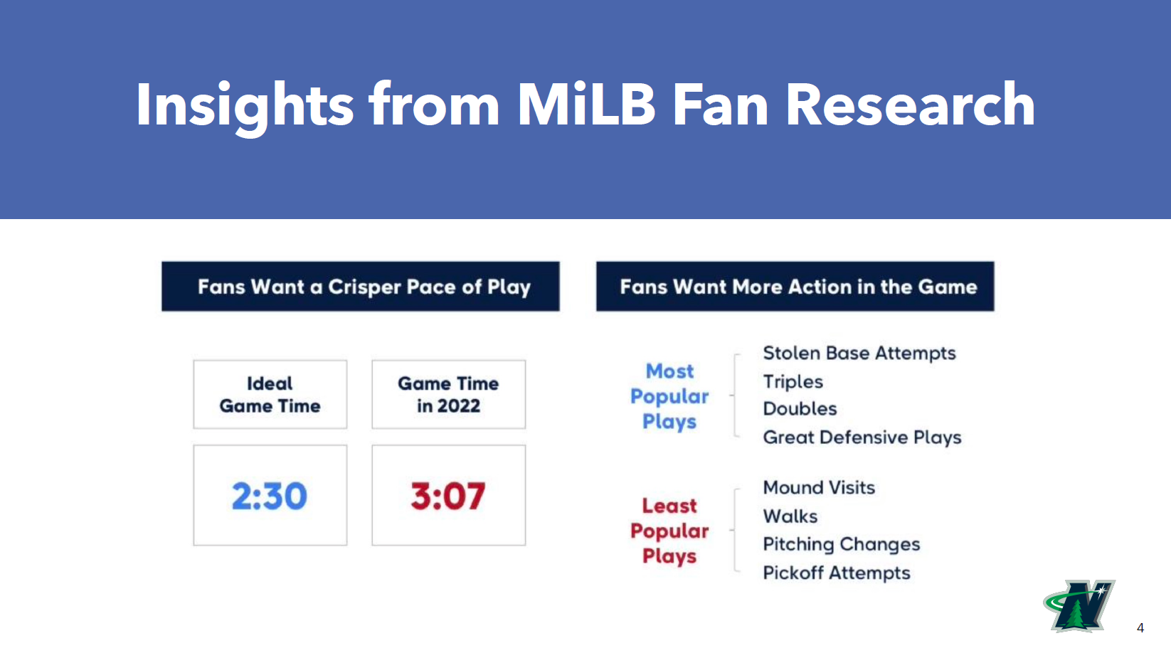
OTHER FACTORS?
WALKS PER GAME?
2022: 11
2023: 11
2024: 11
HITS PER GAME?
2022: 17
2023: 17
2024: 18
RUNS PER GAME?
2022: 12
2023: 12
2024: 13
PA PER GAME?
2022: 82
2023: 82
2024: 82
BASERUNNERS PER GAME?
2022: 32
2023: 32
2024: 33
REACHED ON ERRORS PER GAME?
2022: 2
2023: 2
2024: 2

Slide 5
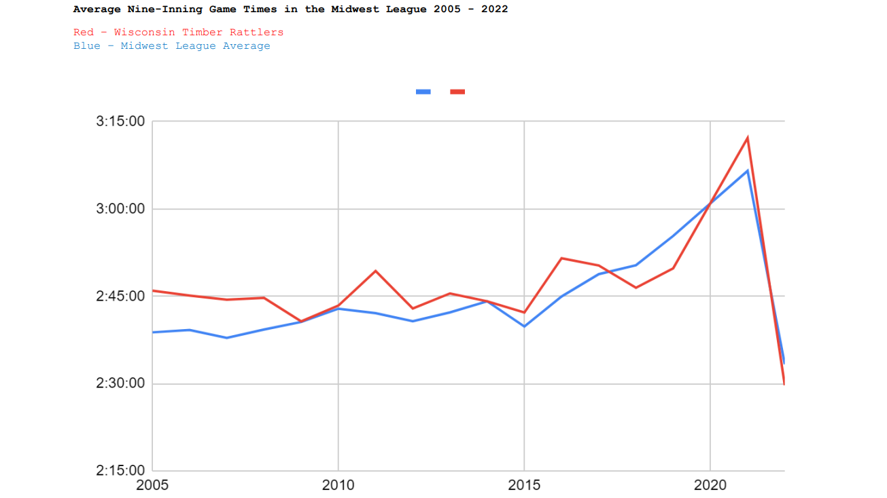
OTHER FACTORS?
WALKS PER GAME?
2022: 11
2023: 11
2024: 11
HITS PER GAME?
2022: 17
2023: 17
2024: 18
RUNS PER GAME?
2022: 12
2023: 12
2024: 13
PA PER GAME?
2022: 82
2023: 82
2024: 82
BASERUNNERS PER GAME?
2022: 32
2023: 32
2024: 33
REACHED ON ERRORS PER GAME?
2022: 2
2023: 2
2024: 2

Slide 6
THROUGH 2024
2022: 3:05 NWL average
2023: 2:50 NWL average
2024: 3:00 NWL average

Slide 7
QUALIFYERS
Only teams that played 2022, 2023, and 2024
Only data from 9-inning games was utilized
Outliers removed (long delays, etc.)

Slide 8
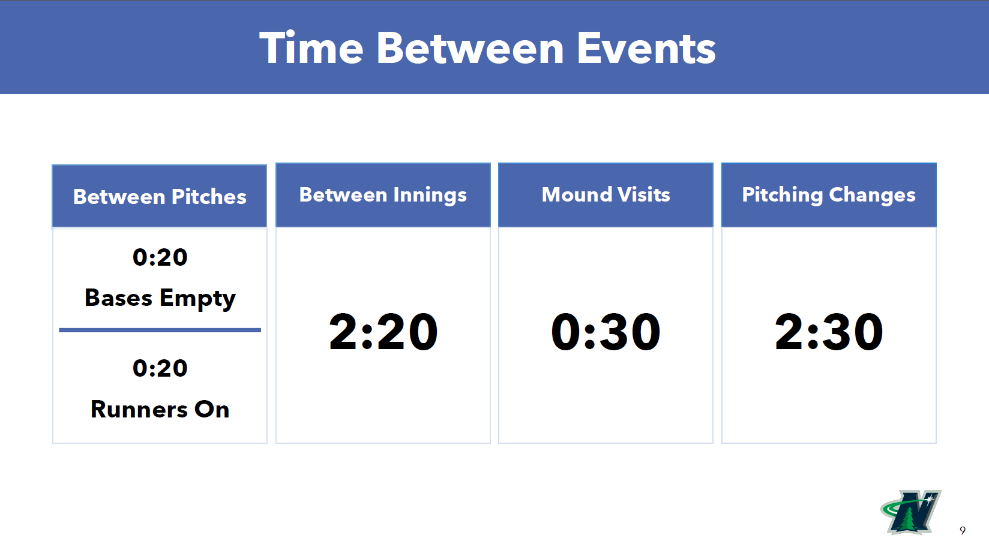
QUALIFYERS
Only teams that played 2022, 2023, and 2024
Only date from 9-inning games was utilized
Outliers removed (long delays, etc.)

Slide 9
OTHER FACTORS?
WALKS PER GAME?
2022: 11
2023: 11
2024: 11
HITS PER GAME?
2022: 17
2023: 17
2024: 18
RUNS PER GAME?
2022: 12
2023: 12
2024: 13
PA PER GAME?
2022: 82
2023: 82
2024: 82
BASERUNNERS PER GAME?
2022: 32
2023: 32
2024: 33
REACHED ON ERRORS PER GAME?
2022: 2
2023: 2
2024: 2

Slide 10
WHAT CAN WE DO?
Follow current timings strictly
Add 0:30 play clock (between plate appearances)
Differentiate from NCAA
Umpire buy-in
Coach buy-in

Slide 11
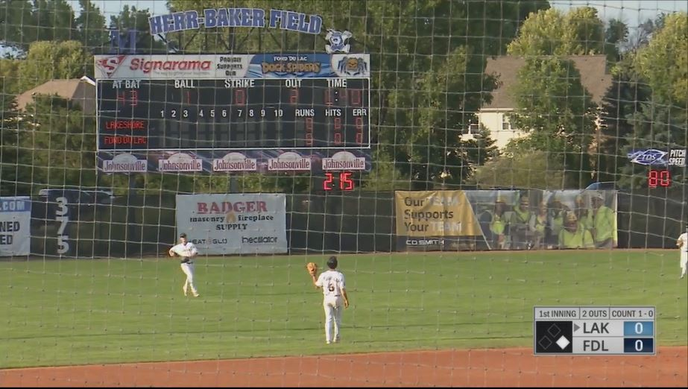
QUESTIONS?
Revenue impact?
Fan engagement?
Atmosphere?
Optics?
Cost of operation?

Slide 12
IF TIME …
PROCEED TO NEXT SLIDES

Slide 13
2022 Team | Average TOG |  | 2023 Team | Average TOG |  | 2024 Team | Average TOG
Battle Creek Battle Jacks | 3:12 |  | Battle Creek Battle Jacks | 2:53 |  | Battle Creek Battle Jacks | 3:02
Bismarck Larks | 3:17 |  | Bismarck Larks | 3:09 |  | Bismarck Larks | 3:14
Duluth Huskies | 3:09 |  | Duluth Huskies | 2:50 |  | Duluth Huskies | 2:49
Eau Claire Express | 2:54 |  | Eau Claire Express | 2:54 |  | Eau Claire Express | 3:14
Fond du Lac Dock Spiders | 3:06 |  | Fond du Lac Dock Spiders | 2:41 |  | Fond du Lac Dock Spiders | 3:00
Green Bay Rockers | 3:01 |  | Green Bay Rockers | 2:51 |  | Green Bay Rockers | 2:54
Kalamazoo Growlers | 3:07 |  | Kalamazoo Growlers | 2:52 |  | Kalamazoo Growlers | 2:44
Kenosha Kingfish | 3:13 |  | Kenosha Kingfish | 2:45 |  | Kenosha Kingfish | 2:47
Kokomo Jackrabbits | 3:00 |  | Kokomo Jackrabbits | 2:56 |  | Kokomo Jackrabbits | 3:14
La Crosse Loggers | 3:16 |  | La Crosse Loggers | 2:55 |  | La Crosse Loggers | 3:07
Lakeshore Chinooks | 3:04 |  | Lakeshore Chinooks | 2:41 |  | Lakeshore Chinooks | 3:02
Madison Mallards | 3:09 |  | Madison Mallards | 2:51 |  | Madison Mallards | 2:48
Mankato Moondogs | 2:58 |  | Mankato Moondogs | 2:49 |  | Mankato Moondogs | 3:06
Rochester Honkers | 3:12 |  | Rochester Honkers | 2:55 |  | Rochester Honkers | 2:57
Rockford Rivets | 3:03 |  | Rockford Rivets | 2:49 |  | Rockford Rivets | 3:17
St.Cloud Rox | 2:58 |  | St.Cloud Rox | 2:51 |  | St.Cloud Rox | 3:10
Traverse City Pit Spitters | 2:58 |  | Traverse City Pit Spitters | 2:36 |  | Traverse City Pit Spitters | 2:40
Waterloo Bucks | 3:16 |  | Waterloo Bucks | 2:58 |  | Waterloo Bucks | 3:02
Wausau Woodchucks | 2:59 |  | Wausau Woodchucks | 2:44 |  | Wausau Woodchucks | 2:57
Willmar Stingers | 3:01 |  | Willmar Stingers | 3:06 |  | Willmar Stingers | 3:12
Wisconsin Rapids Rafters | 3:08 |  | Wisconsin Rapids Rafters | 2:44 |  | Wisconsin Rapids Rafters | 3:03
 | 3:05 |  |  | 2:50 |  |  | 3:00

Slide 15
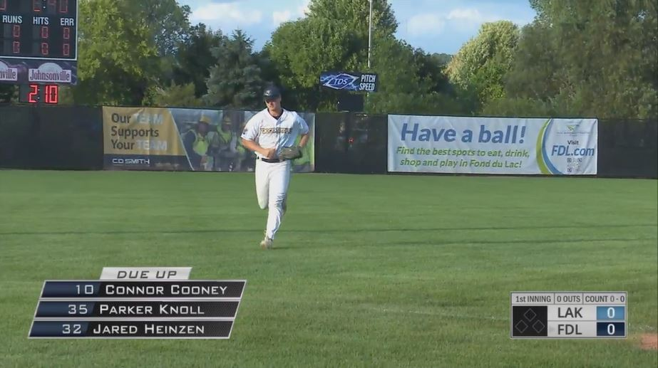
VIDEO EXAMPLES
2:51 BREAK
https://www.dropbox.com/scl/fo/4yp3nj0b9qy0bdhlqw0og/AOnxywCRQ1zVzhE6H0WS7VM?dl=0&e=1&preview=BIS+%40+WIL+Pitch+Clock.mp4&rlkey=b90bf5ajd75i0zxc3pj03gegr&st=20q4ku17
3:10 BREAK
https://www.dropbox.com/scl/fo/4yp3nj0b9qy0bdhlqw0og/AOnxywCRQ1zVzhE6H0WS7VM?dl=0&e=1&preview=WAU+%40+MAD+Pitch+Clock.mp4&rlkey=b90bf5ajd75i0zxc3pj03gegr&st=20q4ku17

